Slide 1




ISWC2014 Tutorial on Large Scale Reasoning Over Semantic Data
Presenters:
Jeff Z. Pan (University of Aberdeen)
Raghava Mutharaju (Wright State University)
Ilias Tachmazidis (University of Huddersfield)
Guilin Qi (Southeast University)

Slide 2
Agenda
9:10am – 9:45am
Motivations and Overview of Background Knowledge (Jeff, Ilias)
9:45am – 10:30am
Scalable OWL 2 DL reasoning based on approximation and divide-and-conquer approaches (Jeff)
10:30am – 11:00am
Coffee break
11:00am – 11:45am
Distributed Reasoning in OWL 2 EL (Raghava)
11:45am – 12:30pm
Large Scale Non-Monotonic Reasoning (Ilias)

Slide 3
Agenda
2:00pm – 2:45pm
Scalable RDFS Reasoning Using MapReduce (Raghava)
2:45pm – 3:30pm
Applications (Raghava, Jeff)
3:30pm – 4:00pm
Coffee break
4:00pm – 4:45pm
Lesson Learned and Conclusions (Jeff)

Slide 4

Distributed Reasoning in OWL 2 EL
Raghava Mutharaju
Department of Computer Science,
Wright State University, USA

Slide 5

Session Agenda
Motivation
Preliminaries
Distributed EL Reasoning
MapReduce
Distributed Queue
Distributed Fixpoint Iteration
Related work
Future Directions

Slide 6
Motivation
Do we even need a motivating scenario for thinking of scalable solutions ☺
Include scalability as part of requirements. But, nevertheless, ….

Slide 7
Motivation
Ontologies generated automatically from sensors and text can be very large.
Streaming traffic data in Dublin produces 21 million axioms in a day.
Several billion axioms in a short span.

Slide 8
Motivation
Current in-memory reasoners cannot scale.
A distributed approach to ontology reasoning is required.
More memory and processing power.

Slide 9
Preliminaries
OWL 2 EL is one of the profiles of OWL 2.
OWL 2 EL is based on the description logic EL++.
C := A | T | | C D| r.C |{a}
C D; C(a); r(a, b); r o s t

Slide 10
Preliminaries
Reasoning task of focus here is classification.
Classification: computation of complete subsumption hierarchy.
ABox reasoning can also be reduced to classification.

Slide 11
Preliminaries
Completion Rules
To classify an ontology a set of completion rules are applied iteratively on the axioms.
They are applied until no new output is produced.
S(X) is the set containing all the superclasses of X.
R(r) = {(A, B)} implies that A r.B

Slide 12
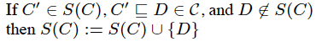
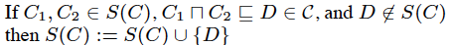
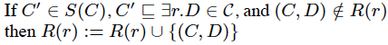
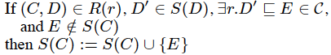
Preliminaries
R1
R2
R3
R4

Slide 13
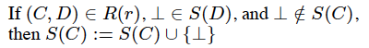
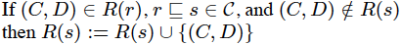
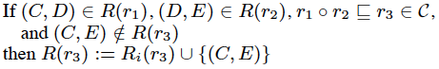
Preliminaries
R5
R6
R7

Slide 14
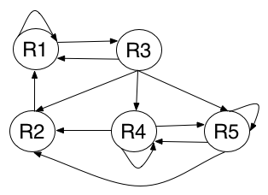
Rule Dependency
Every rule is dependent on one or more rules.
Cannot be an embarrassingly parallel computation. There will be an overhead.

Slide 15
MapReduce
MapReduce approach applied to RDFS and OWL Horst gave favorable results.
This idea was carried over to EL+
Axioms are represented in the form of key-value pairs.

Slide 16
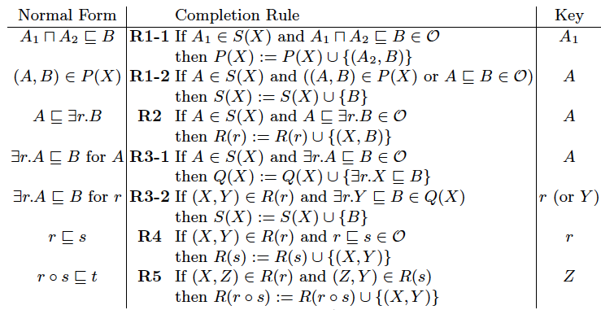
MapReduce
Slightly modified rule set

Slide 17
MapReduce
MapReduce can handle 2-way joins in one job.
Each rule is a MapReduce job.
In map phase, an axiom that satisfies the precondition of a rule is given as output in the form of a key-value pair.

Slide 18
MapReduce
Axioms with same key are grouped from different mappers and passed to the reducer.
Joins are handled in reduce.

Slide 19
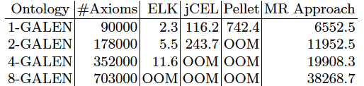
MapReduce
Results
Cluster of 8 nodes. Each node has 2 cores.
3GHz processor with 2GB RAM.

Slide 20
Distributed Queue
On a single machine
Fixpoint iteration – naïve
Queue approach – efficient
Let us see if these observations also hold in a distributed setup.

Slide 21
Distributed Queue
For each concept, a queue is assigned.
Depending on the entry of the queue, appropriate rules are triggered.
This goes on until all the queues are empty.

Slide 22
Distributed Queue
In a distributed setup, axioms are represented as key-value pairs.
Axioms are distributed across the cluster based on their keys.
Each machine works on only the queues local to it, but gets the missing data from other nodes.

Slide 23
Distributed Queue
Termination
A single process called Termination Controller (TC) keeps track of the status.
TC receives DONE/NOT-DONE message from each machine.
A double-check termination strategy is followed.
After receiving DONE from all the nodes, it asks all the nodes to check whether local queues are empty.

Slide 24
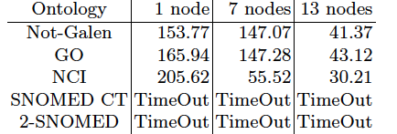
Distributed Queue
Result
13-node cluster with each node having two quad core AMD Opteron 2300MHz processors.
12GB heap size

Slide 25
Distributed Fixpoint Iteration
Completion rules applied iteratively until no changes to S(X) and R(r).
Axiom distribution
O = O₁ U … U O₇
Each O_{i} is assigned to a group of nodes.

Slide 26
Distributed Fixpoint Iteration
Rule R_{i} is applied on the corresponding O_{i}.
For example, R₁ is applied on O₁.
For a rule application, if data from other node is required, it communicates with that node directly

Slide 27
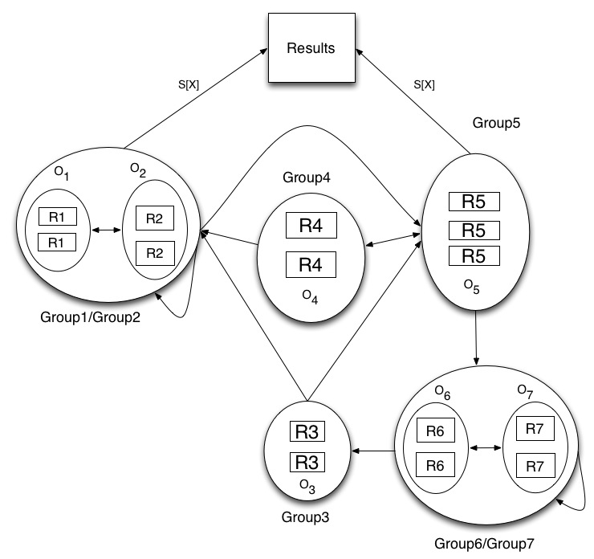

Slide 28
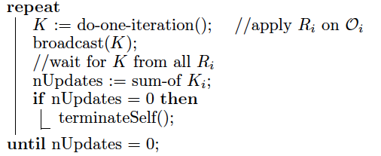
Distributed Fixpoint Iteration
There is no shared memory and communication happens by message passing.
Termination:

Slide 29
Distributed Fixpoint Iteration
Axioms are represented in the form of key-value pairs.
Given a key, the location of an axiom in the cluster can be known easily.

Slide 30
Distributed Fixpoint Iteration
Results
GO, GALEN, FMA, SNOMED, 2-SNOMED, SNOMED-GALEN-GO (SGG) and Traffic are the test datasets.
2-SNOMED is SNOMED duplicated twice.
SGG is a merge of three ontologies with some of the concept/role names shared among the three.

Slide 31
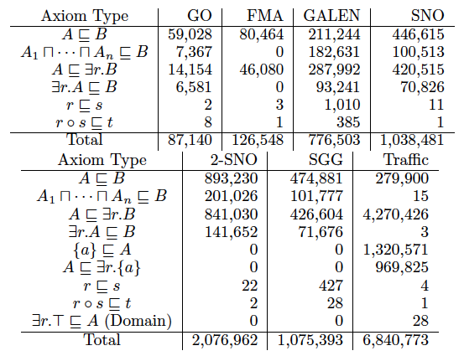
Distributed Fixpoint Iteration

Slide 32
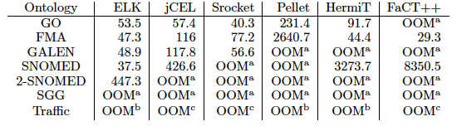
Distributed Fixpoint Iteration
32 node cluster where each node has 2 quad core AMD Opteron 2300MHz.
4GB is available to JVM on each node.

Slide 33
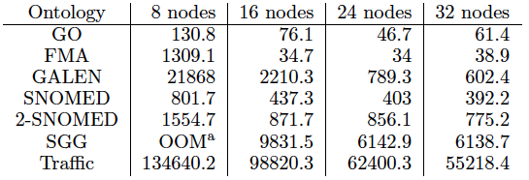
Distributed Fixpoint Iteration
Runtime decreases as nodes increase.
No OOM and if there, more nodes can be added.

Slide 34
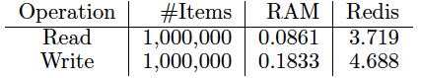
Distributed Fixpoint Iteration
Comparison with single machine reasoners is unfair.
More resources available in a cluster.
In-memory operations on a single machine are lot faster. Read is 43 times faster and Write is 25 times faster.

Slide 35
Related Work
Very little implemented, evaluated work on OWL 2 EL that is published.
Distributed Resolution technique was tried in [Stuckenschmidt 2011]. (No evaluation results)
Peer-to-peer approach for OWL EL [Dumontier 2009]. (No evaluation results)
Some work on parallelization on a single machine.

Slide 36
Future Directions
Better comparison scheme
Existing reasoners can be re-implemented with the storage system used by the distributed reasoners.
Alternative approaches
Axiom distribution based on ontology modules and graph partitioning can be tried.
Hadoop variants such as Spark (in-memory), Iterative MapReduce can be tried.

Slide 37
Future Directions
Use of alternative rule sets and classification procedures can be tried (Eg., ELK).
Distributed approaches to more expressive description logics such as SROIQ.

Slide 38
Conclusions
Developing a distributed reasoner can be error-prone and time consuming.
Also, a distributed framework suitable for one description logic might not be suitable for another.
Each distributed framework is useful for a particular set of use cases.

Slide 39
Conclusions
A suitable framework can alleviate the development efforts.
During the framework selection
Analyze the description logic and the data, along with the strengths/weaknesses of the framework.
Model the performance of the distributed approach.

Slide 40
Acknowledgements
This work was supported by the National Science Foundation under award 1017225 “III: Small: TROn - Tractable Reasoning with Ontologies.”
I thank the US National Science Foundation (NSF) for travel support.

